Slide 1
Group O

Slide 2
Introduction
Question: Do expert grades for high school football correlate to collegiate level success?
Analyze high school football recruiting rankings and college statistics for offensive skills player

Slide 3
Getting the Data
Data sources
College Football Stats
ESPN College Football High School Recruits

Slide 4
Cleaning Data

Slide 5
Functions

Slide 6
Problems

Slide 7
Outcome
Checked difference between original rankings and end of year rankings
Two different outcomes based on treatment of NA
With NA = 49, rankers weren’t very accurate
Unfairly penalized for lack of rankings
With NA removed, rankers were more accurate
Takes only their actual ranking opinions into account

Slide 8
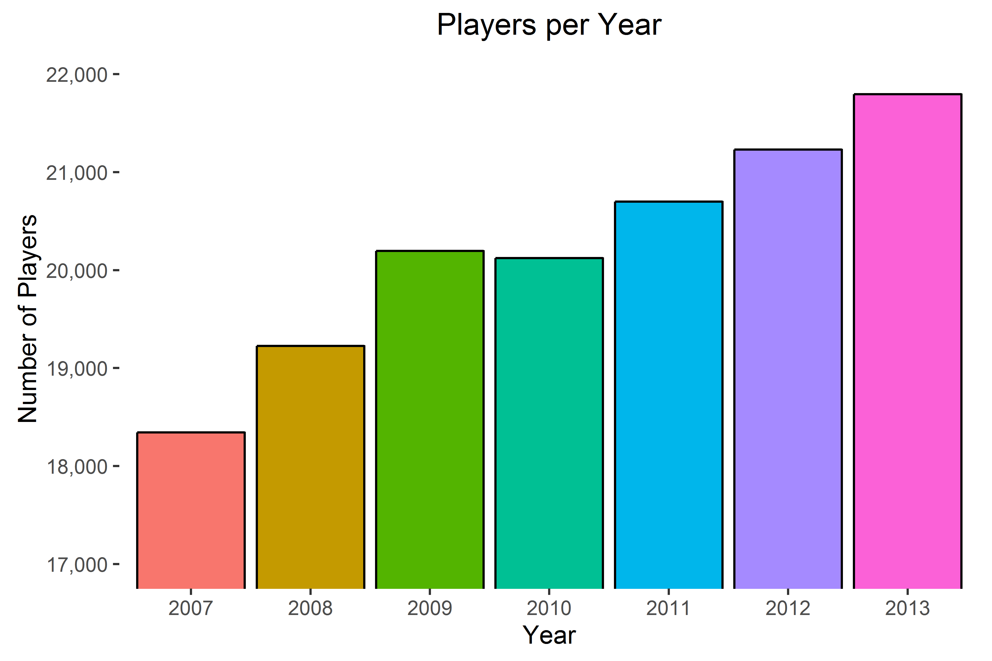
Player Pool

Slide 9
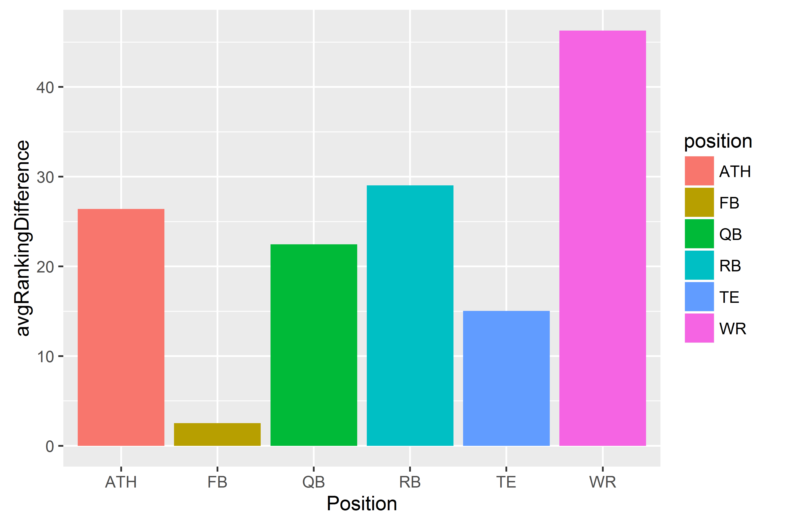
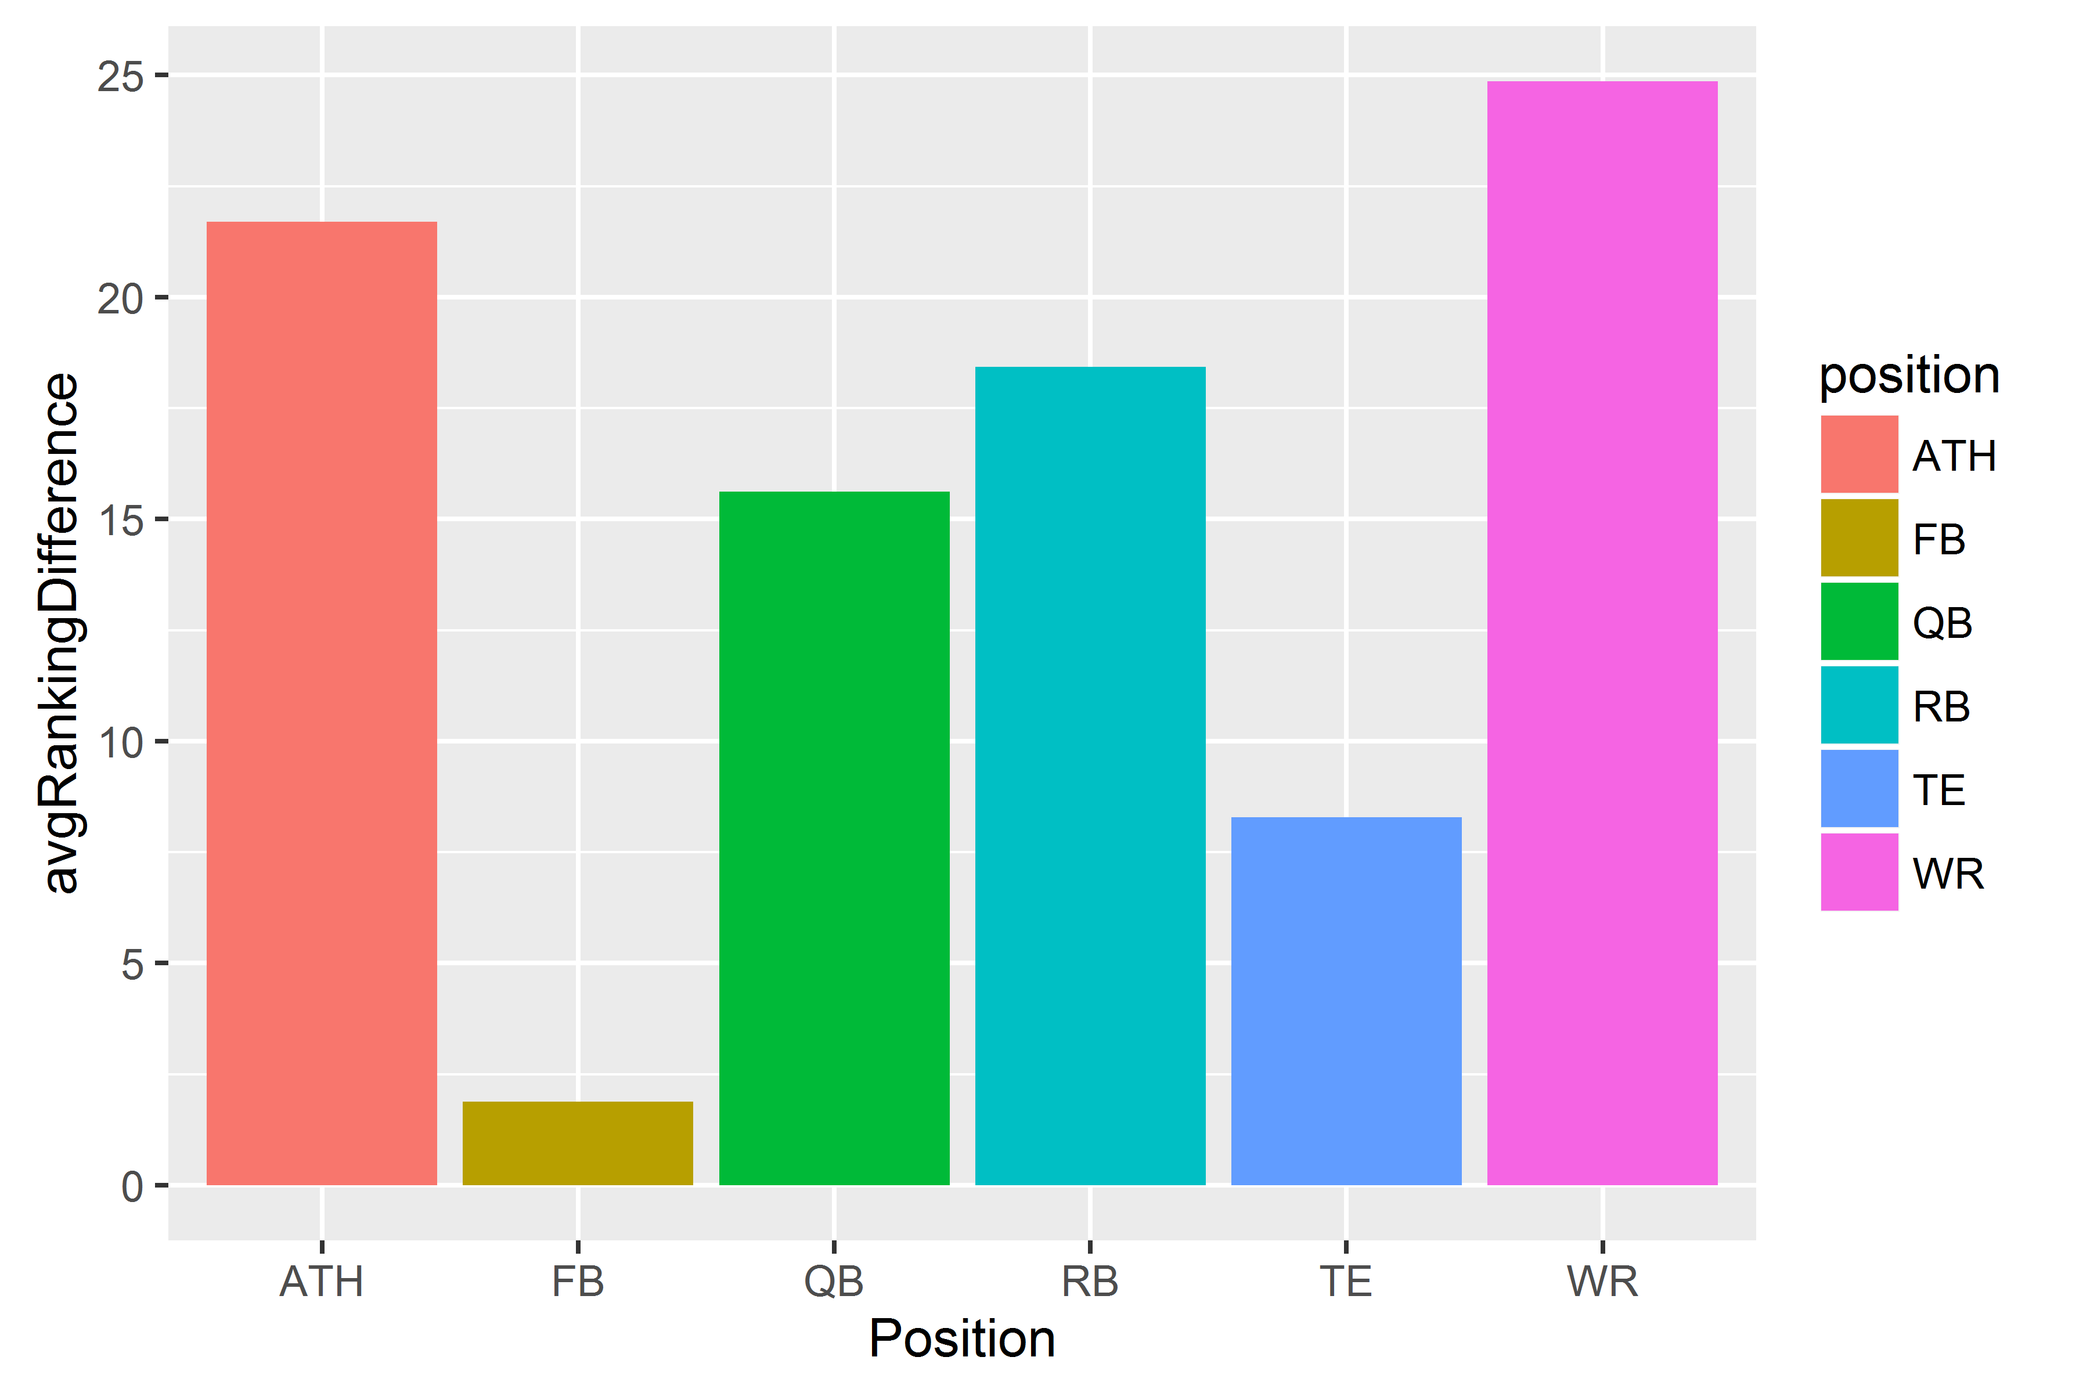
By Position

Slide 10
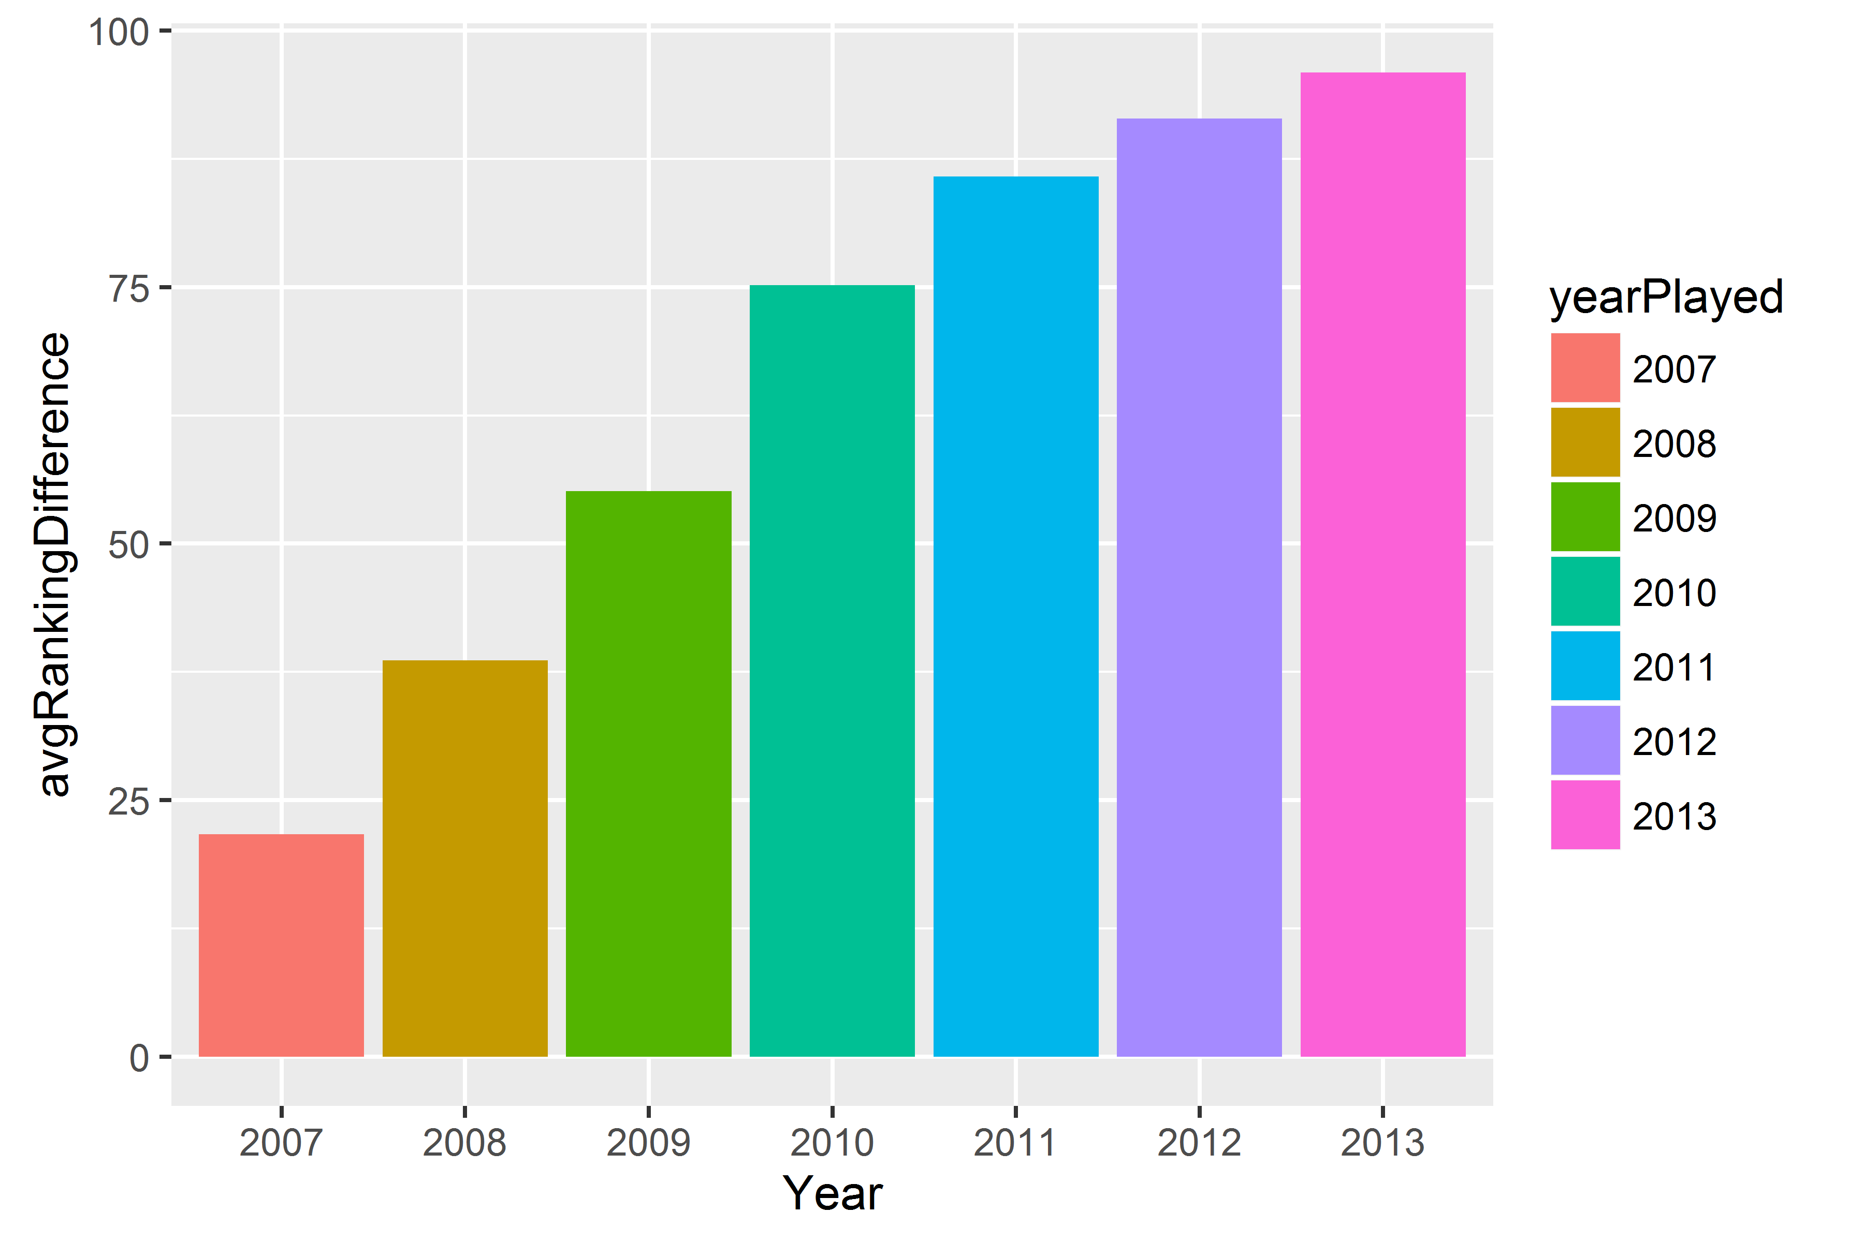
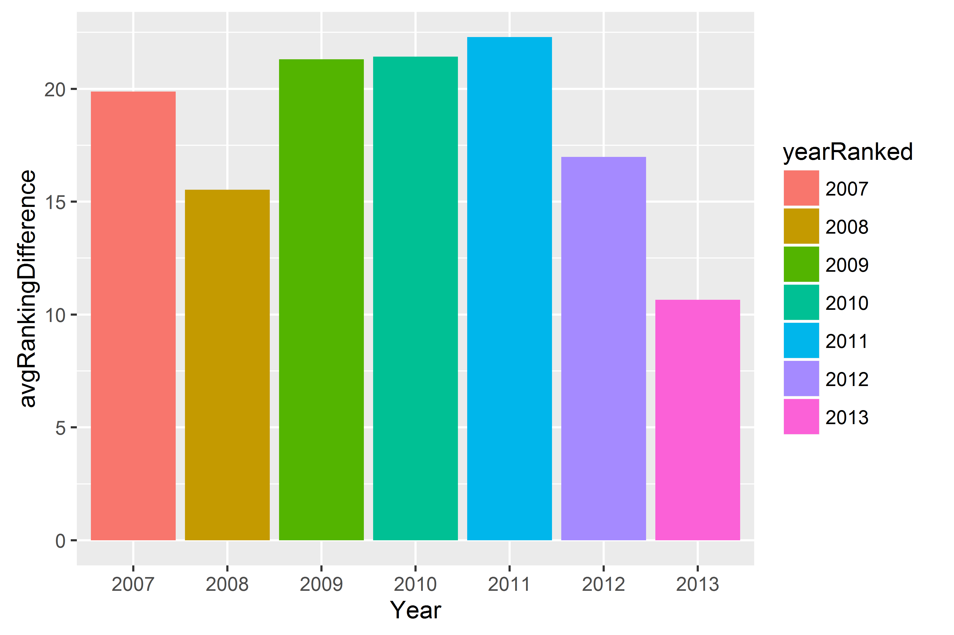
By Year

Slide 11
Combined Position and Year

